Slide 1
CONDITIONAL SENTENCES

Slide 2
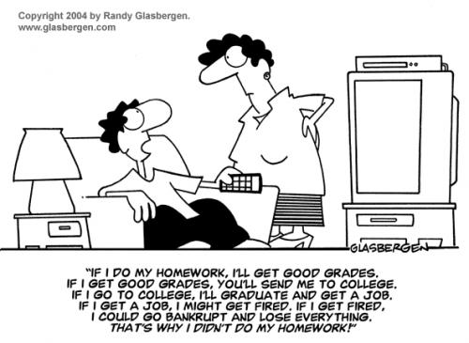

Slide 3
FINISH THESE SENTENCES
If I pass my Analytical Chemistry exam, I will….
If I passed my Analytical Chemistry exam, I would…
If I had passed my Analytical Chemistry exam, I would have…

Slide 4
ZERO CONDITIONAL
The Zero Conditional is formed in this way:
if + Present Simple, Present Simple
If you heat water, it boils.
We use Zero Conditional to describe rules and situations where one event always follows the other.
If you want to study in the USA, you have to pass an exam in English.

Slide 5
FIRST CONDITIONAL
The First Conditional is formed in this way:
if + Present Simple, will + infinitive
If you go to the Zoo, you will see the lions.
We use the First Conditional to talk about possible future events that depend on other future events.
If I pass my exams, my parents will buy me a scooter.
Other possible patterns in the First Conditional:
If we save enough money, we can go on holiday. – can
If you see him, tell him to give me a ring. - imperative

Slide 6
SECOND CONDITIONAL
The second Conditional is formed in this way:
if + Past Simple, would / could / might + infinitive
If I had enough money, I would buy a new car.
We use the Second Conditional:
1. To talk about imagined, impossible or unlikely events in the future.
If I had enough money, I would love to do something like that. (the sentence refers to the future)
2. To talk about impossible present situations.
If I were you, I would study more.

Slide 7
THIRD CONDITIONAL
The Third Conditional is formed in this way:
if + Past Perfect, would/could/might + Perfect Infinitive
If I had studied more, I would have passed the exam.
We use the Third Conditional to talk about unreal situations in the past and to imagine things that did not happen.
If I hadn’t broken my leg, I would have gone skiing.

Slide 8
UNLESS = IF NOT
You don’t get fit unless you exercise regularly.
You don’t get fit if you don’t exercise regularly.
I won’t go there unless we take a taxi.
I won’t go there if we don’t take a taxi.

Slide 9
TEST EXAMPLES
If you ask him, he ___________ (take) you to the airport.
The view was wonderful. If I ______________(have) a camera with me, I would have taken some photographs.
You know that I can’t afford this ring. If I earned more, I ________________(buy) you the whole world.
It’s a pity I didn’t go to Spain last summer. If I had gone there, I ____________________ (have) a chance to use my Spanish.
If I were you, I ______________ (take) your neighbour to court.

Slide 10
TEST EXAMPLES
If you ask him, he will take you to the airport.
The view was wonderful. If I had had a camera with me, I would have taken some photographs.
You know that I can’t afford this ring. If I earned more, I would buy you the whole world.
It’s a pity I didn’t go to Spain last summer. If I had gone there, I would have had a chance to use my Spanish.
If I were you, I would take your neighbour to court.

